Slide 1
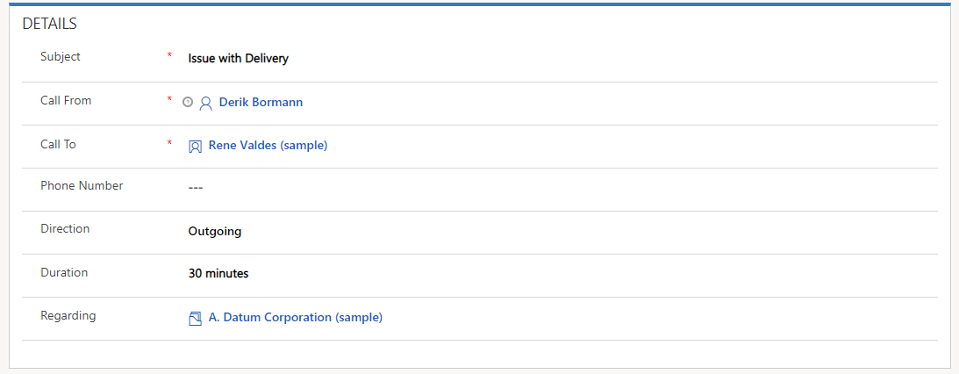

Slide 2
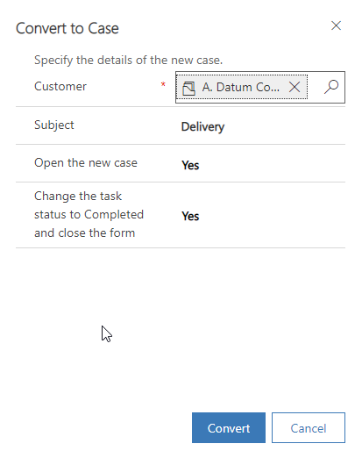

Slide 3
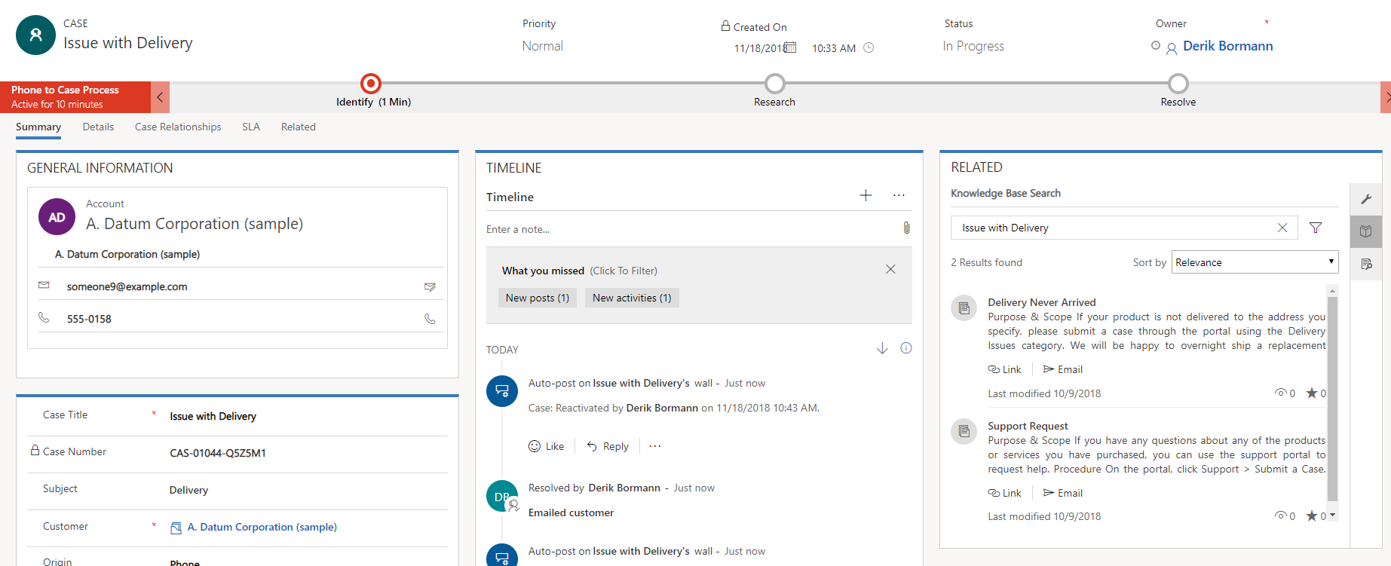
Knowledge Base Search Icon
Link Article Icon

Slide 4
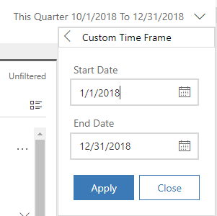

Slide 5
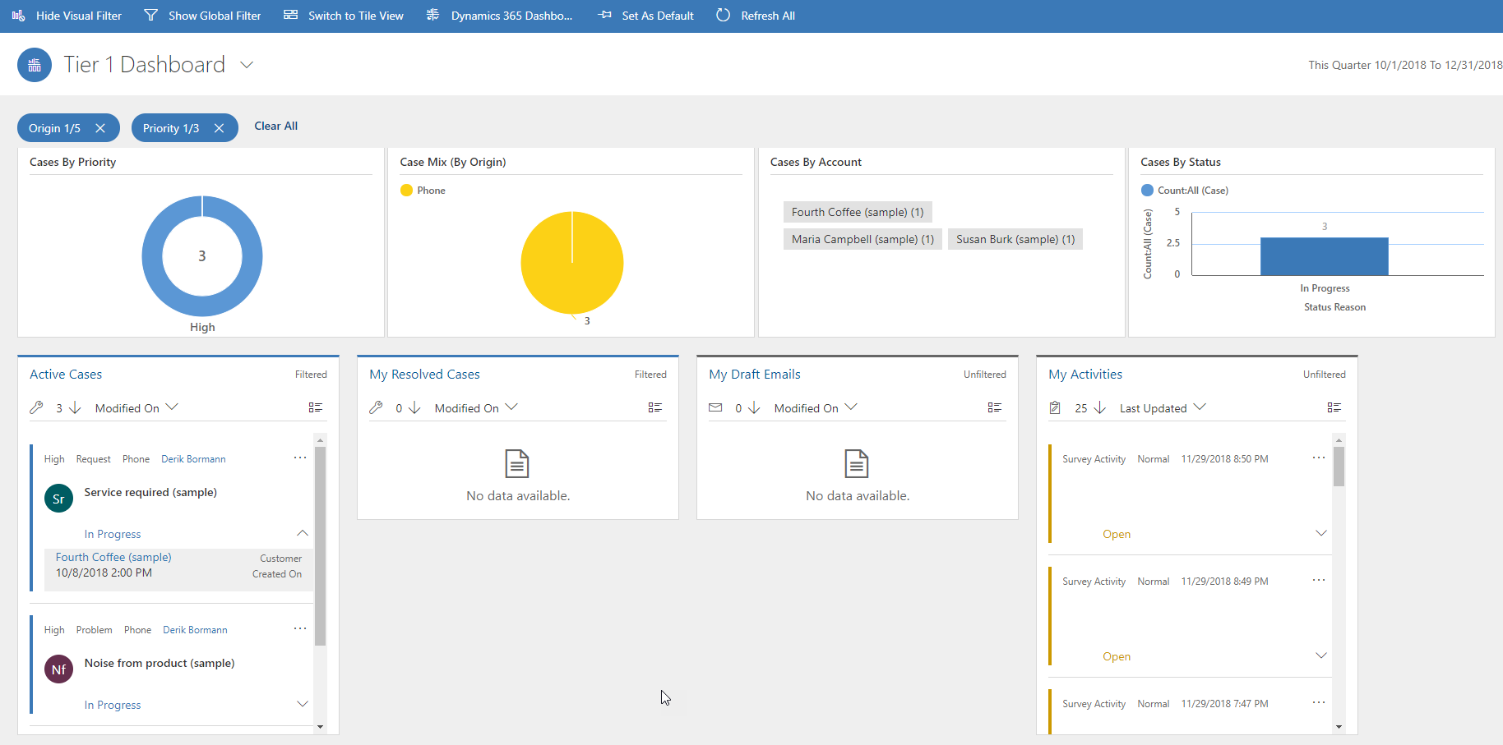
Show Global Filter
1
Filter by High Priority
Filter by Phone Category
3
2
Select to open
5
Expand to verify fourth coffee
4

Slide 6
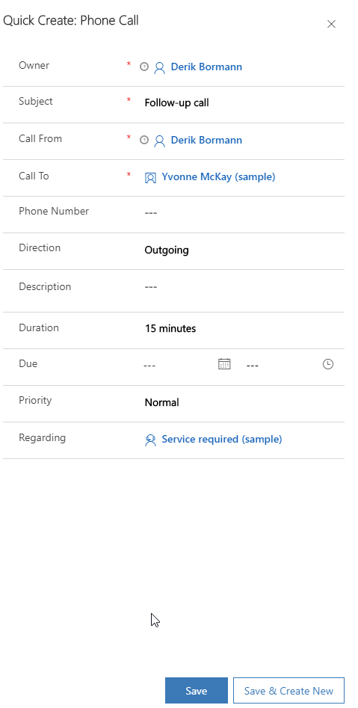

Slide 7
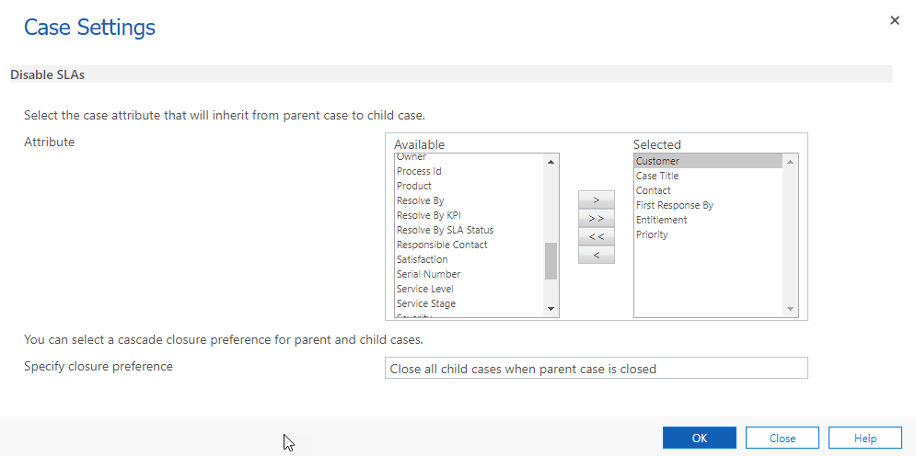

Slide 8
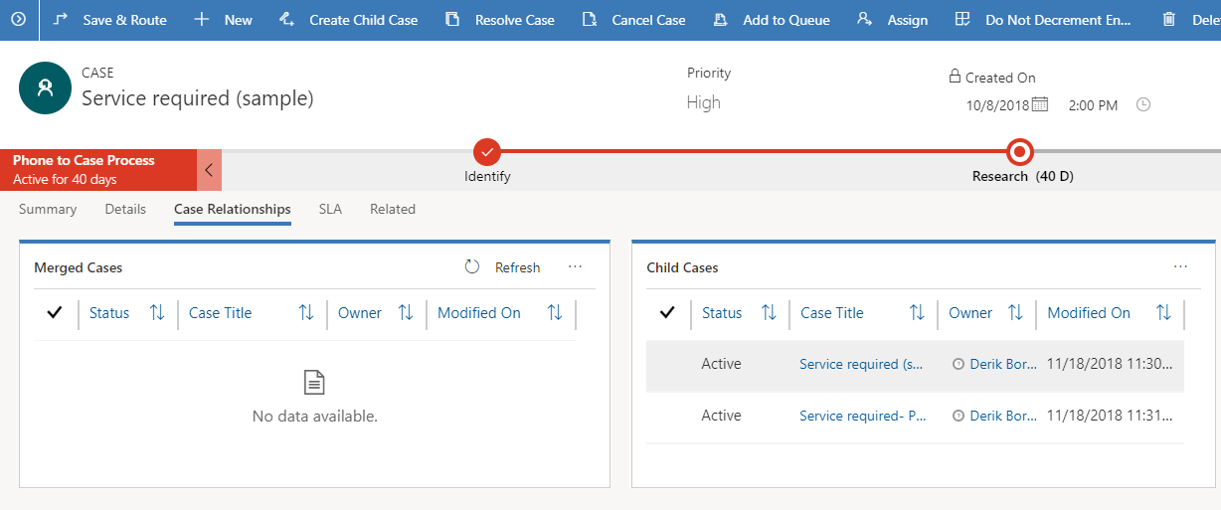
Create Child Case
1
Displays All Child Cases

Slide 9
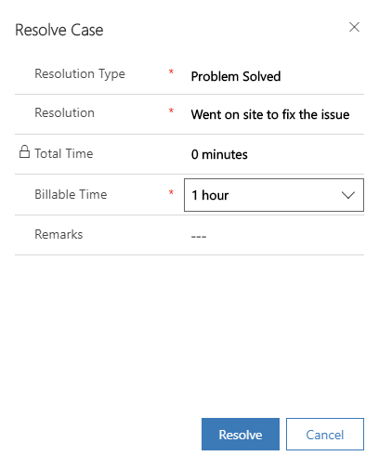

Slide 10
